Slide 2
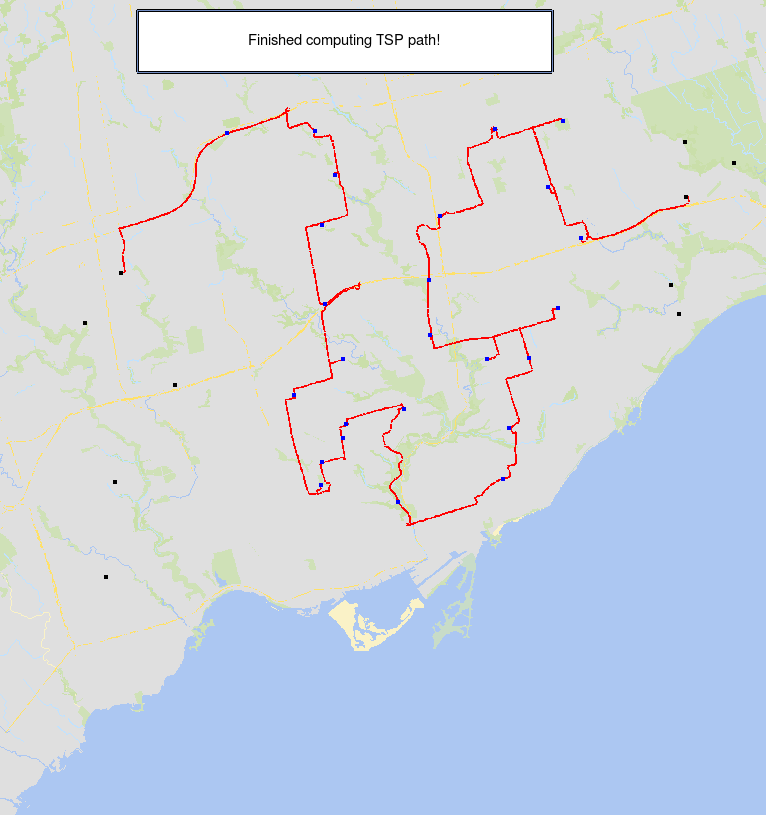
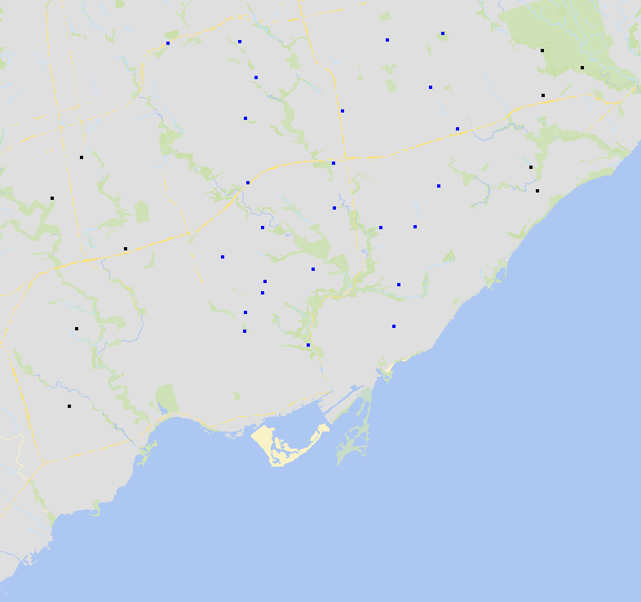
[ Depots ]
[ Drop-offs ]
[ Depots ]

Slide 3
AccessMap
Speedy precision, intuitive features, usability for everyone.

Slide 4
Today's Agenda
Live Demo of AccessMap
Key Innovations, or What Makes AccessMap So Great?
The Future of AccessMap

Slide 5
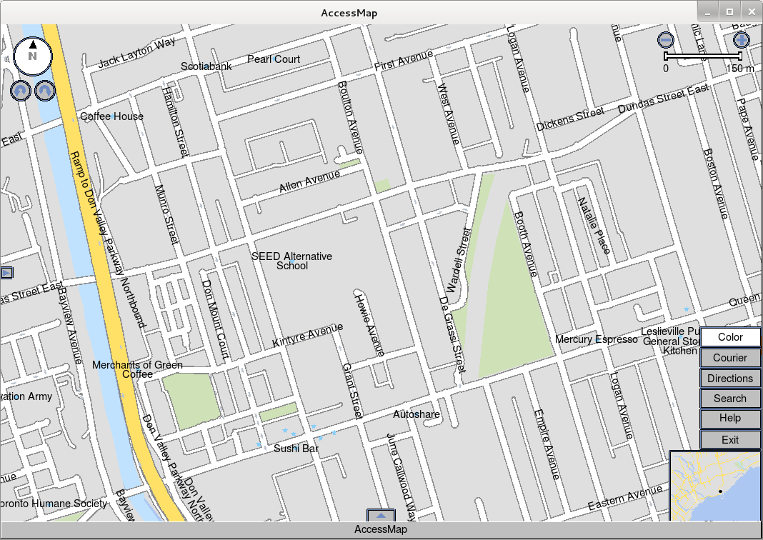

Slide 6
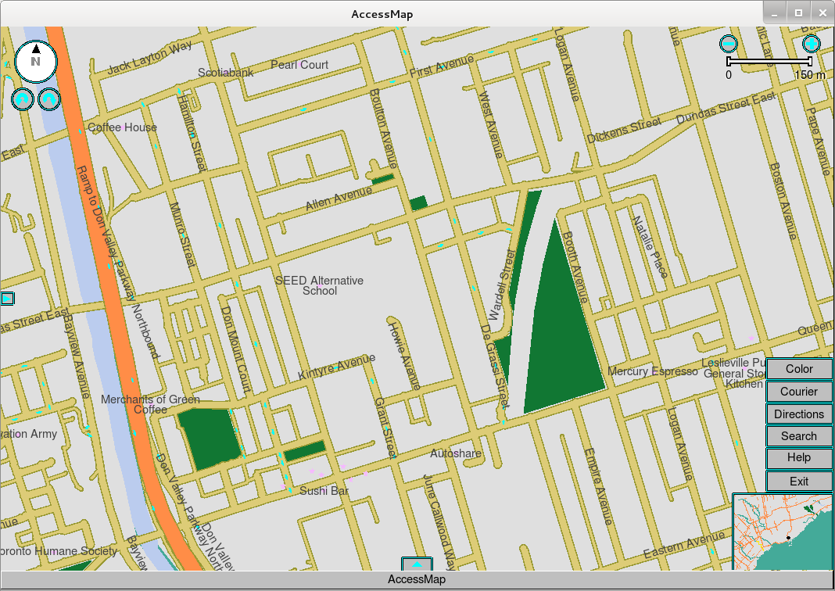
Colorblind
Palettes

Slide 7
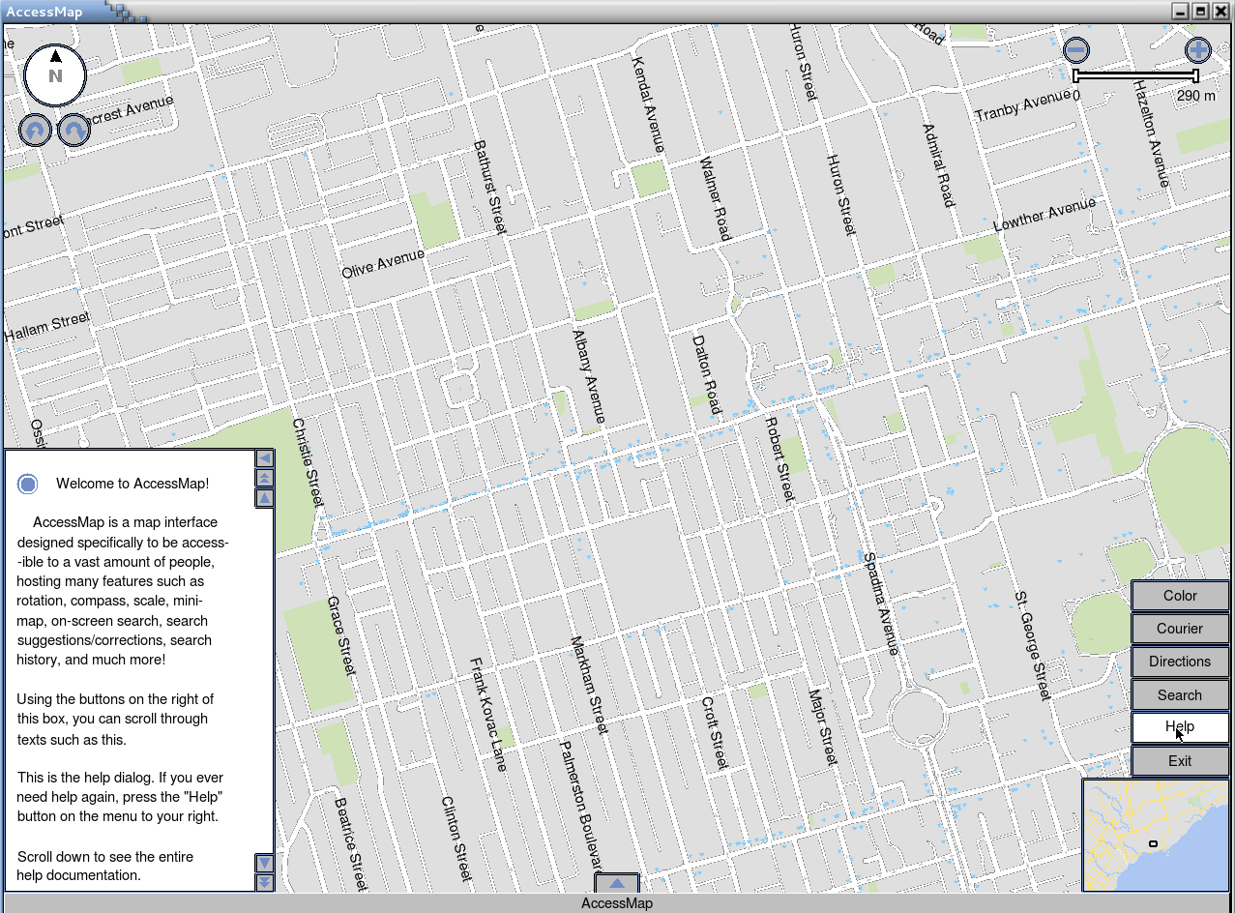
Help Dialog

Slide 8
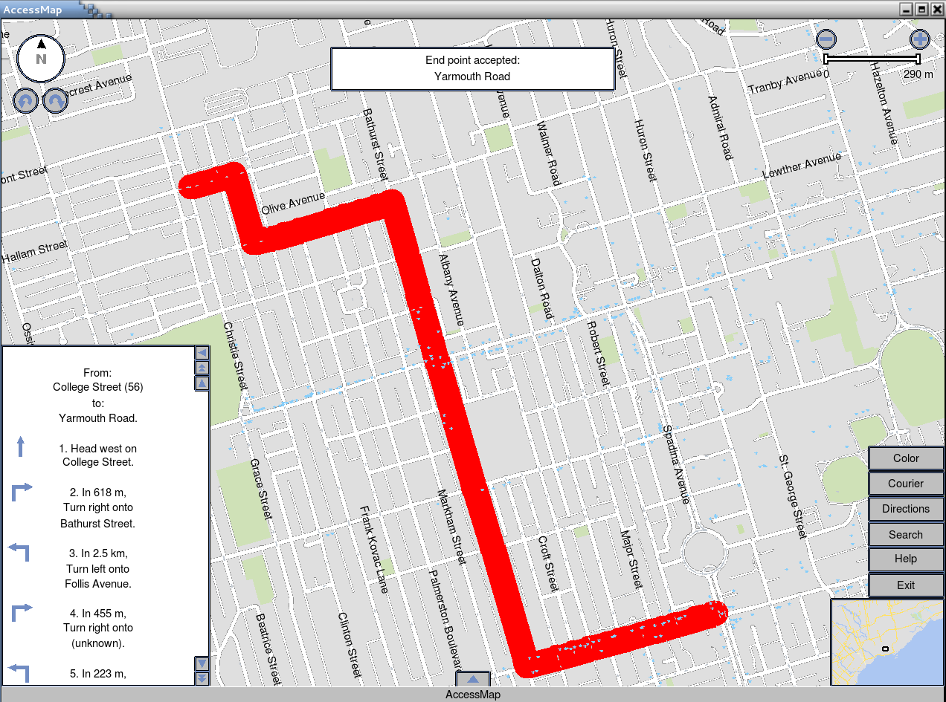
Finding
directions

Slide 9
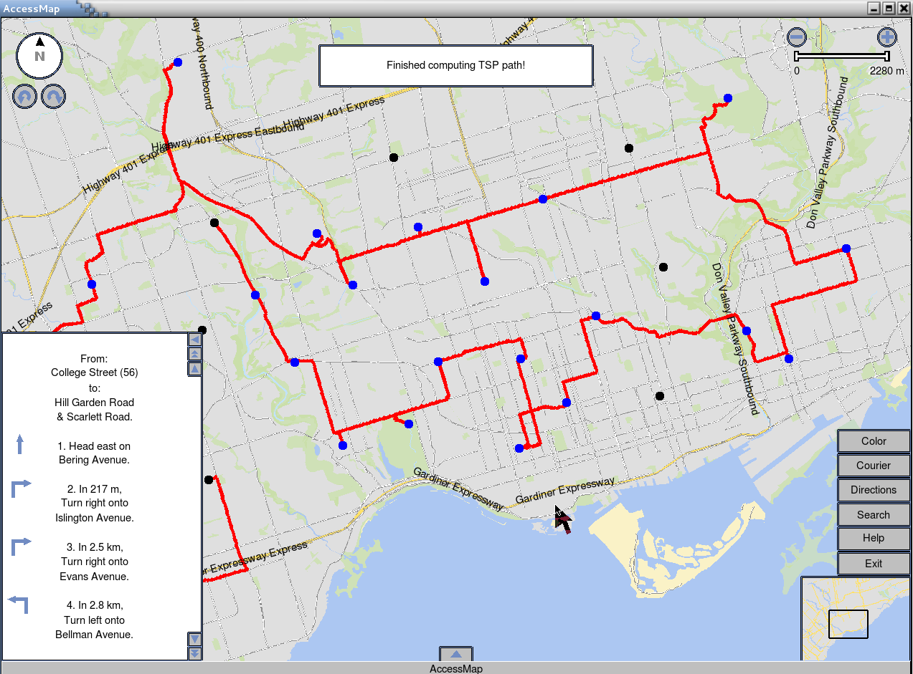
Courier route
planning

Slide 10
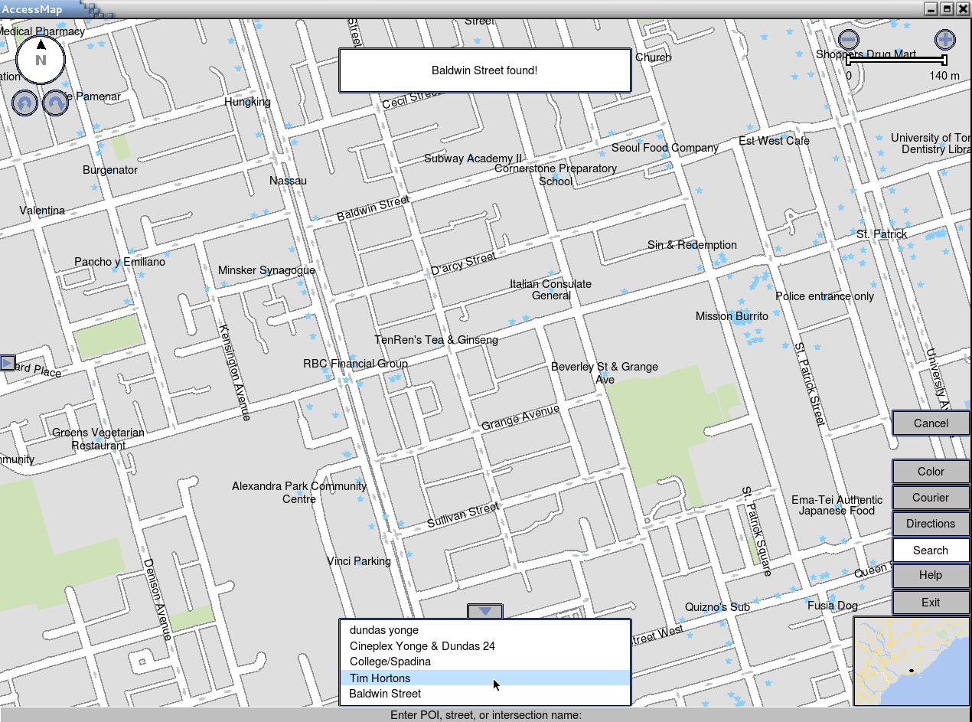
Search history

Slide 11
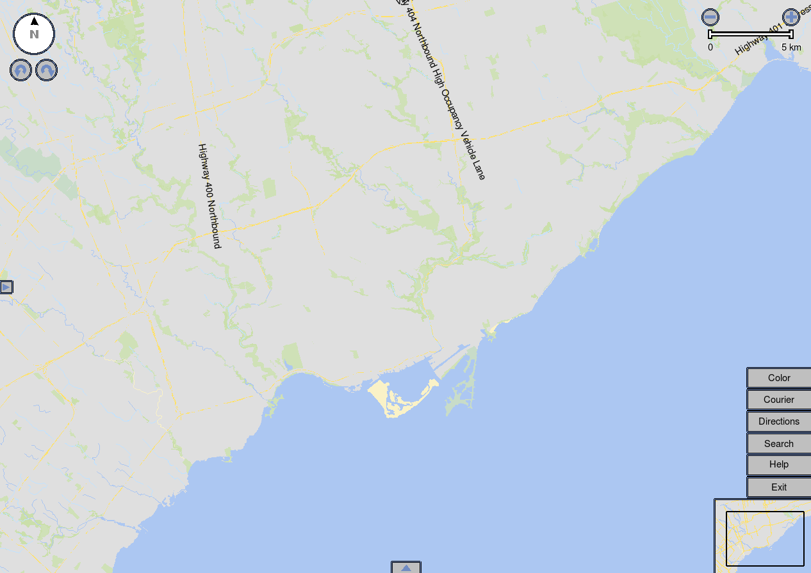
Minimalistic
aesthetics

Slide 12
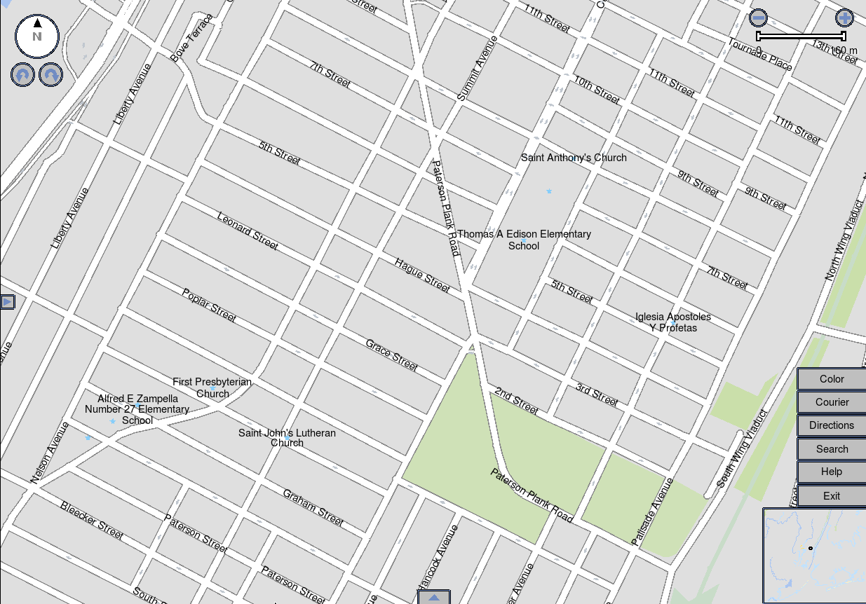
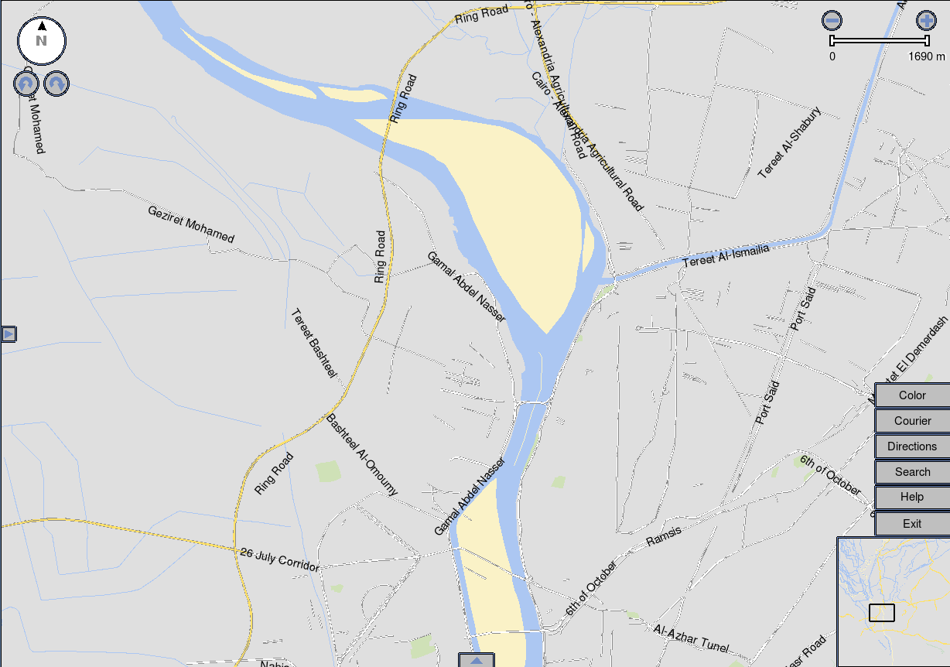
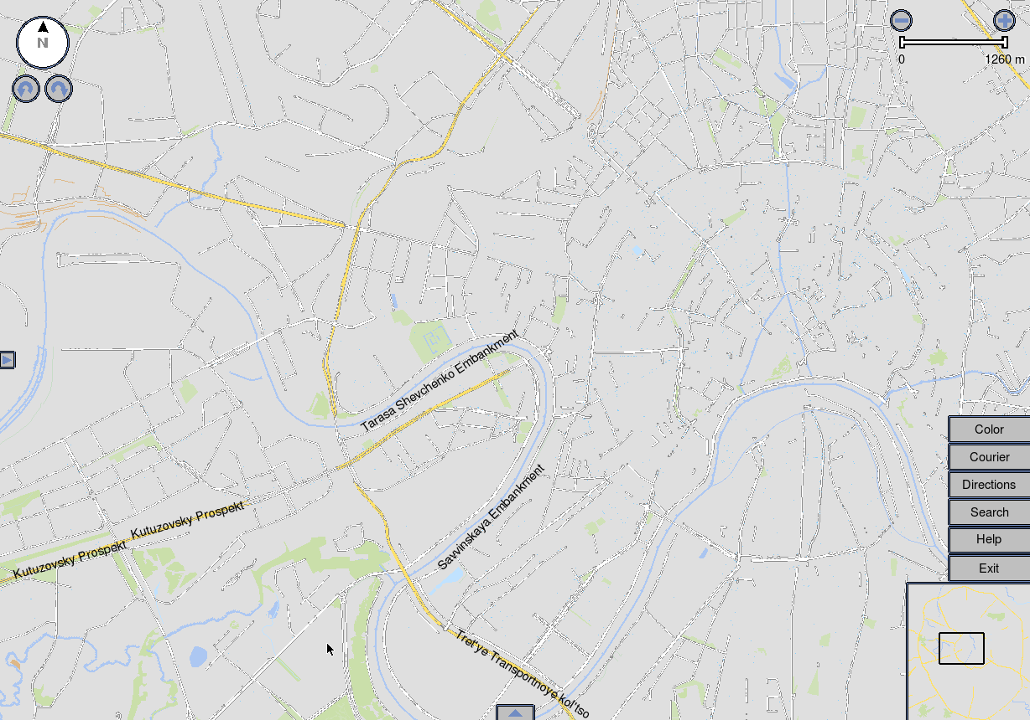
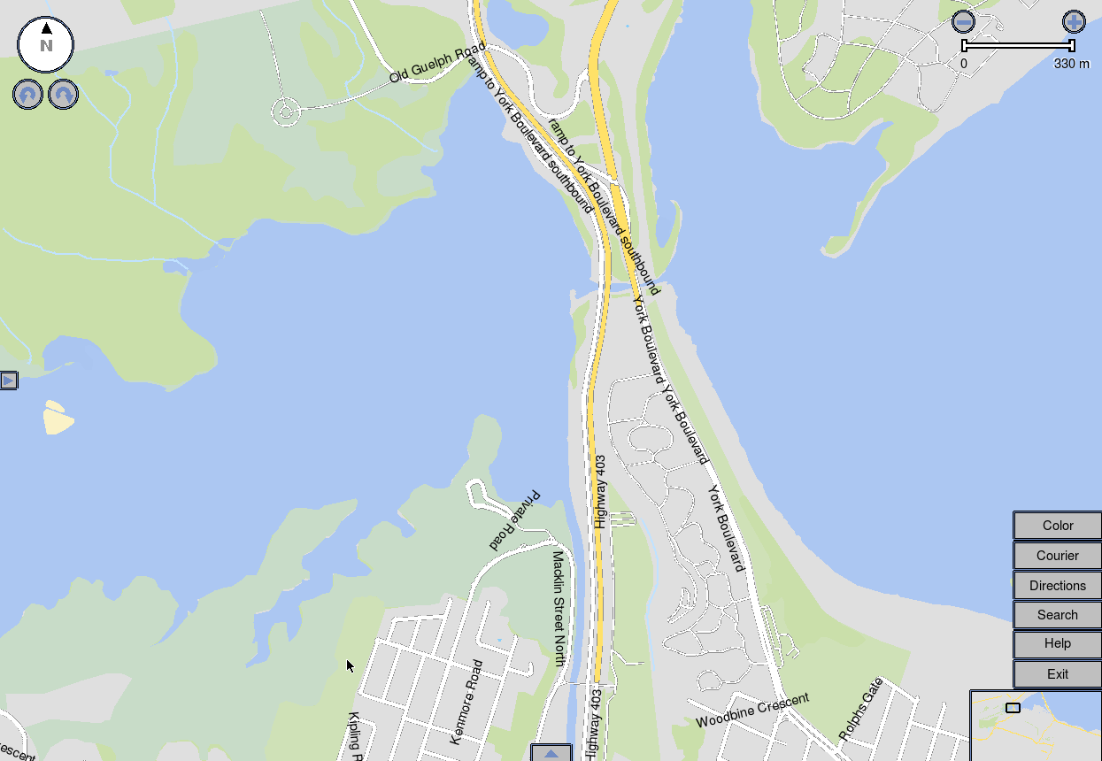
New York
Cairo
Moscow
Hamilton

Slide 13
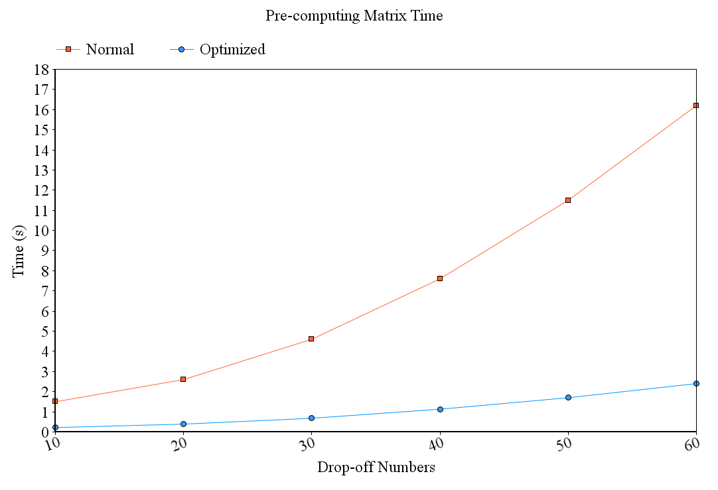

Slide 14
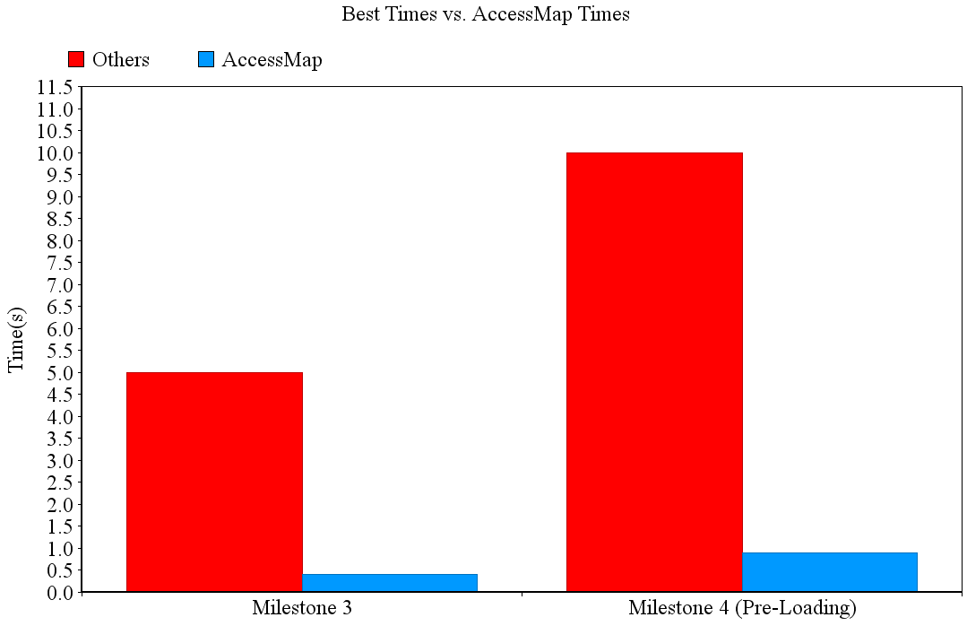

Slide 15
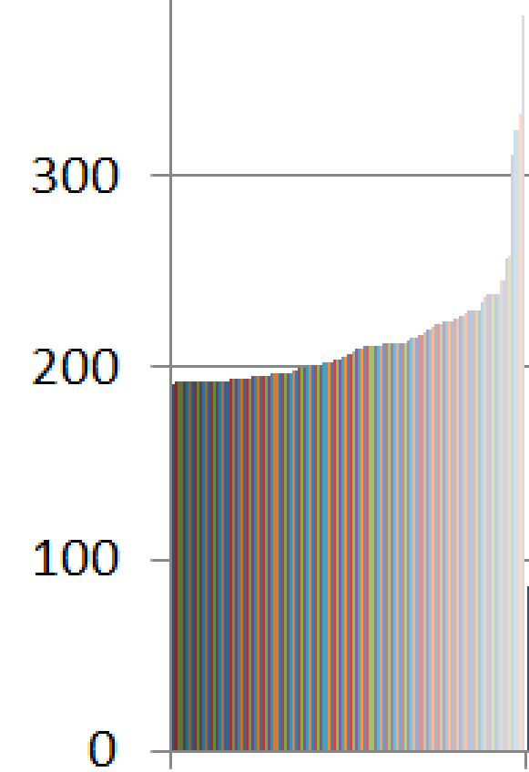
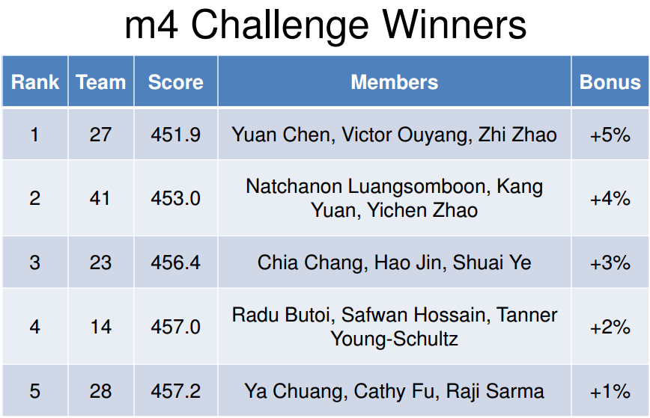
AccessMap

Slide 16
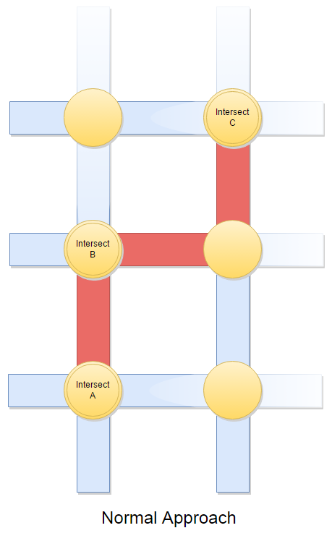
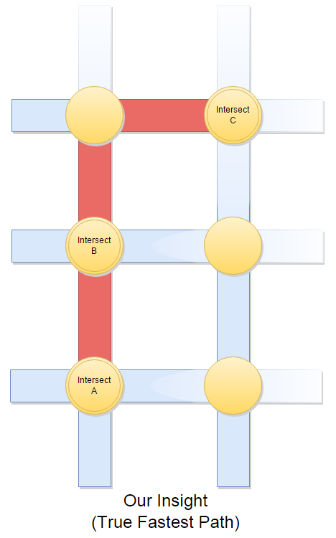

Slide 17
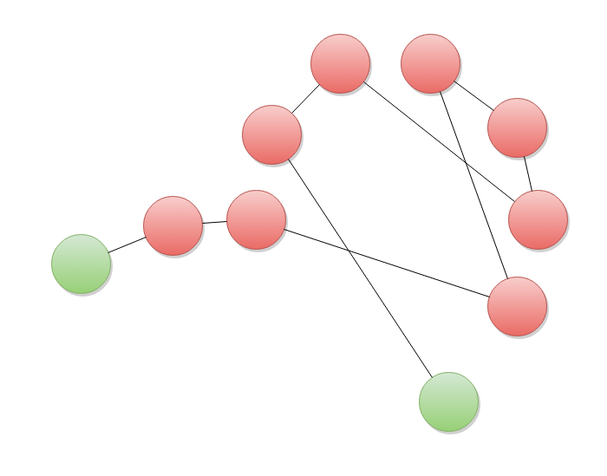
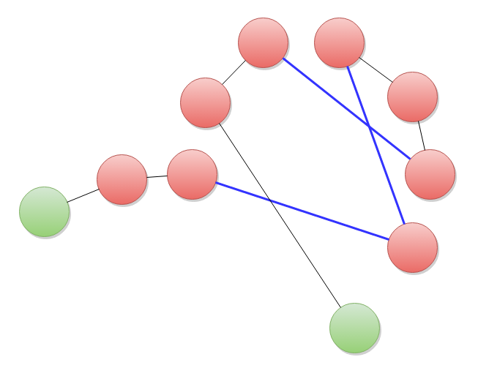
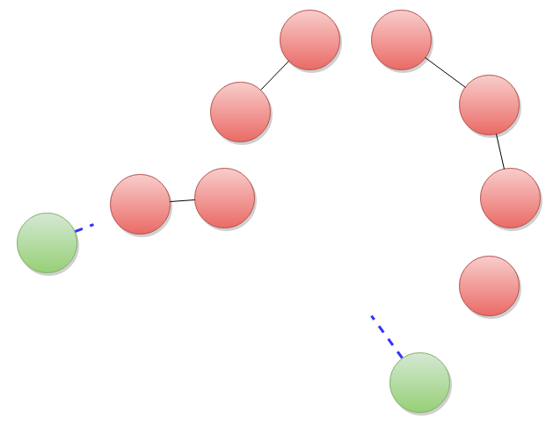
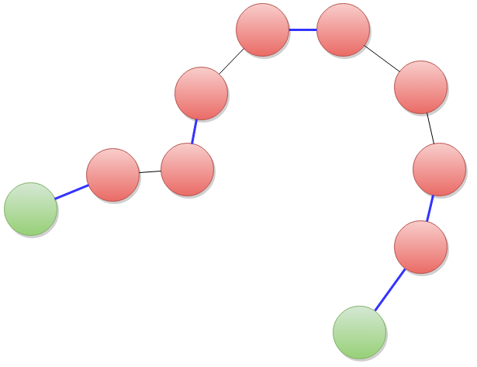
3-opt

Slide 18
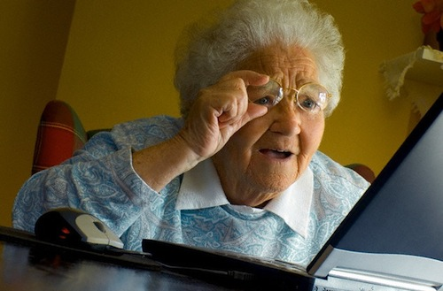
Why Sound?
Many users may have difficulty reading text
Poor/failing eyesight, dyslexia, illiteracy

Slide 19
Diphone Concatenation
Tokenize input text
Apply letter-to-sound rules
Retrieve diphone samples from database
Output sound through PulseAudio
"COMPUTER" → /kəmˈpyu tər/
C+ CO + OM + MP + PU + UT + TE + ER + R

Slide 20
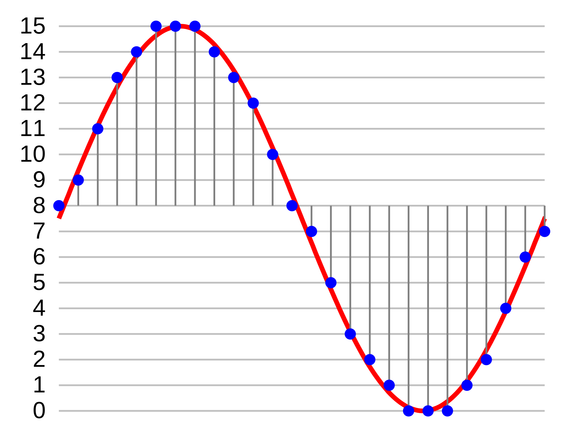
Sound Engine
Uses PulseAudio libraries
Very low level!

Slide 21
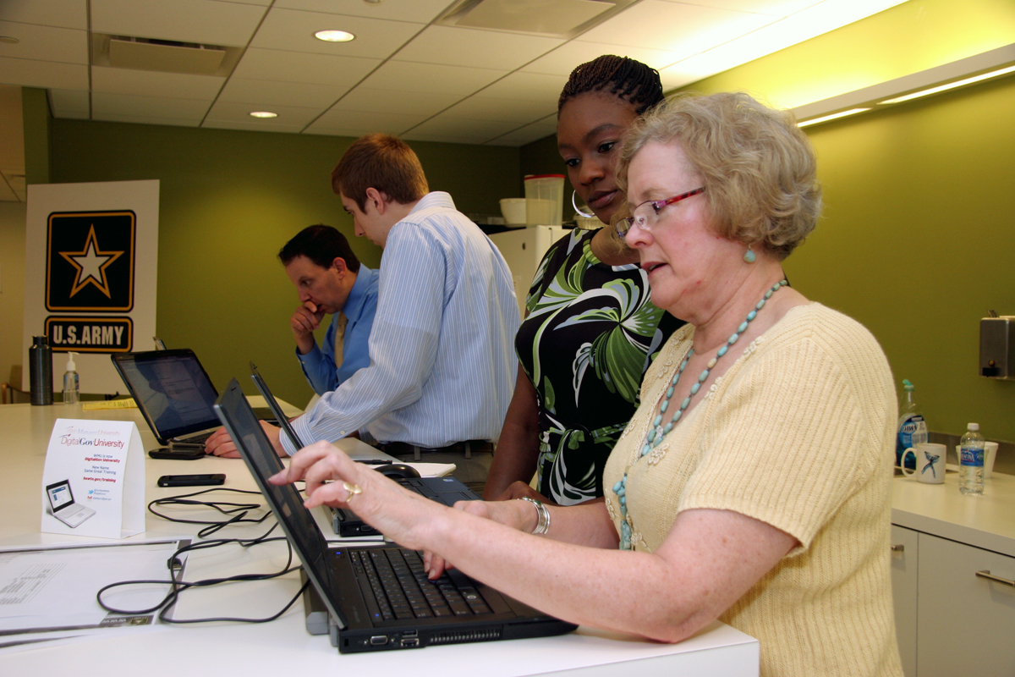
What's in the future?
Many areas for growth
Sound/text-to-speech
Visual improvements
Further human testing

Slide 22

A Seed for Growth
Integration with emerging technologies: smartphones, self-driving cars
Kickstart a revolution in the market for accessibility

Slide 23
Thanks for listening!
Questions?

